Slide 1

Geometry
Unit 13, Lesson 7 Centroids of Triangles Volume 2, pg. 321

Slide 2


Benchmark
MA.912.GR.3.3
Use coordinate geometry to solve mathematical and real-world geometric problems involving lines, circles, triangles, and quadrilaterals.
volume 2, pg. 321

Slide 3
Integrated Mathematical Thinking and Reasoning Standards
MA.K12.MTR.1.1 Actively participate in effortful learning both individually and collectively.
MA.K12.MTR.2.1 Demonstrate understanding by representing problems in multiple ways.
MA.K12.MTR.4.1 Engage in discussions that reflect on the mathematical thinking of self and others.
MA.K12.MTR.5.1 Use patterns and structure to help understand and connect mathematical concepts.
MA.K12.MTR.7.1 Apply mathematics to real-world contexts.
volume 2, pg. 321

Slide 4

Learning Target
I can use coordinate geometry to identify the centroid of a triangle.
volume 2, pg. 321

Slide 5

Warm-Up
volume 2, pg. 322

Slide 6
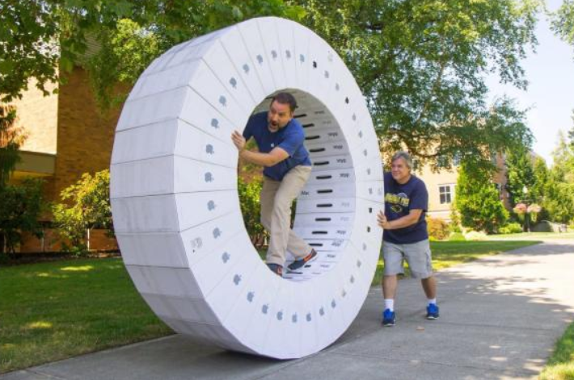
13.7.1 Warm-Up: Human Hamster Wheel
A human hamster wheel is shown.
volume 2, pg. 322

Slide 7
What is the first question that comes to your mind?
What are two things you notice about the human hamster wheel?
volume 2, pg. 322

Slide 8

Exploration
volume 2, pg. 322

Slide 9
13.7.2 Exploration: Centroids of Triangles
$∆HKR$ has vertices at $H(−7,3)$, $K(2,8)$, and $R(5,1)$.
volume 2, pg. 322

Slide 10
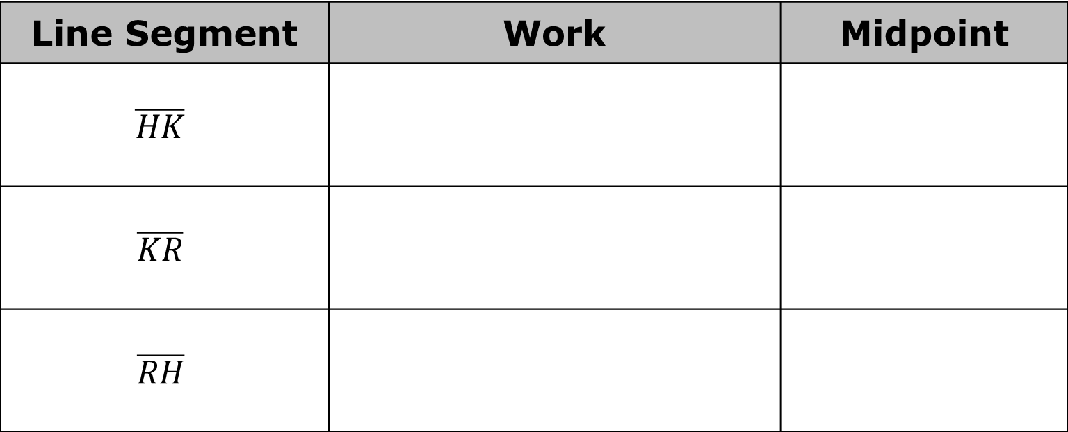
Complete the table by finding the midpoint of each line segment.
Line Segment | Work | Midpoint
$$\overline{HK}$$
$$\overline{KR}$$
$$\overline{RH}$$
volume 2, pg. 322

Slide 11
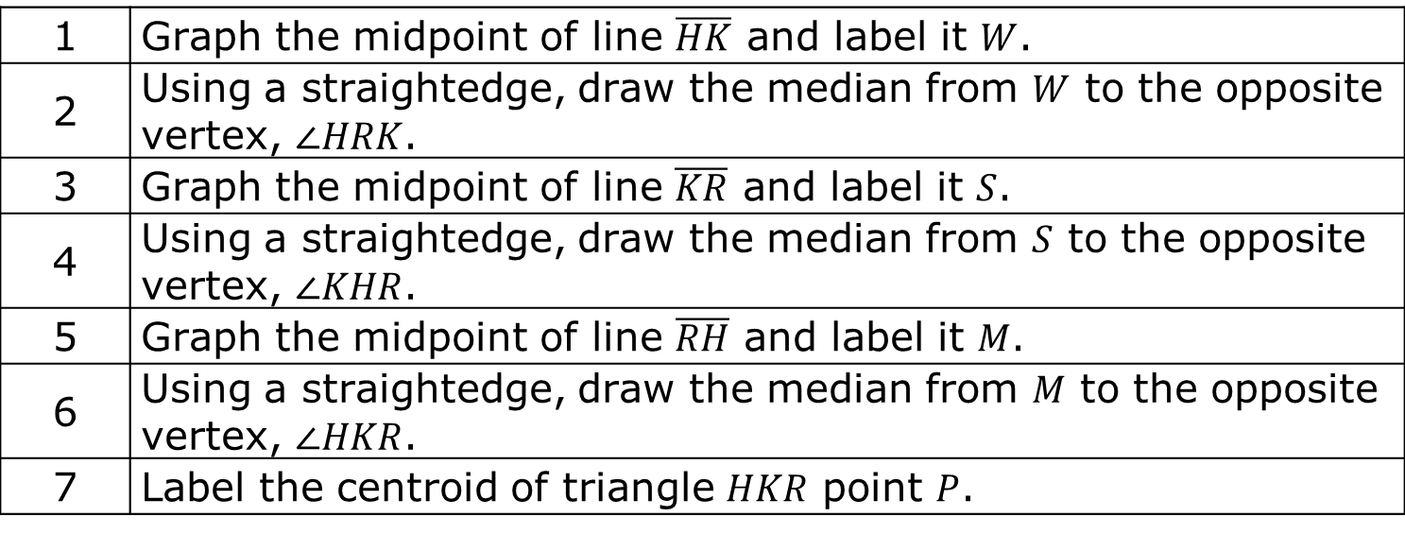
Complete the steps to find the centroid of triangle 𝐻𝐾𝑅.
1 | Graph the midpoint of line $\overline{HK}$ and label it $W$.
2 | Using a straightedge, draw the median from $W$ to the opposite vertex, $∠HRK$.
3 | Graph the midpoint of line $\overline{KR}$ and label it $S$.
4 | Using a straightedge, draw the median from $S$ to the opposite vertex, $∠KHR$.
5 | Graph the midpoint of line $\overline{RH}$ and label it $M$.
6 | Using a straightedge, draw the median from $M$ to the opposite vertex, $∠HKR$.
7 | Label the centroid of triangle $HKR$ point $P$.
What are the coordinates of the centroid of ∆𝐻𝐾𝑅?
volume 2, pg. 323

Slide 12
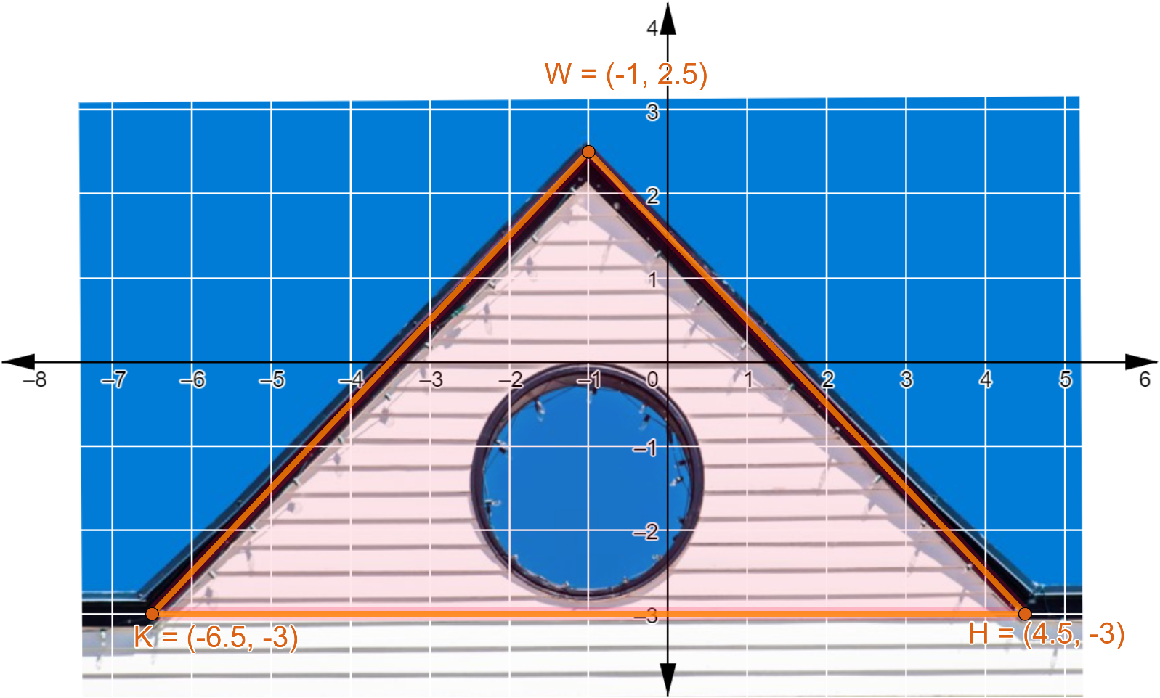
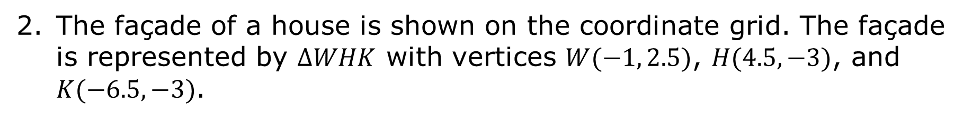
The façade of a house is shown on the coordinate grid. The façade is represented by $∆WHK$ with vertices $W(−1, 2.5)$, $H(4.5, −3)$, and $K(−6.5, −3)$.
Work with your partner to estimate the location of the centroid of the triangular façade.
volume 2, pg. 323

Slide 13
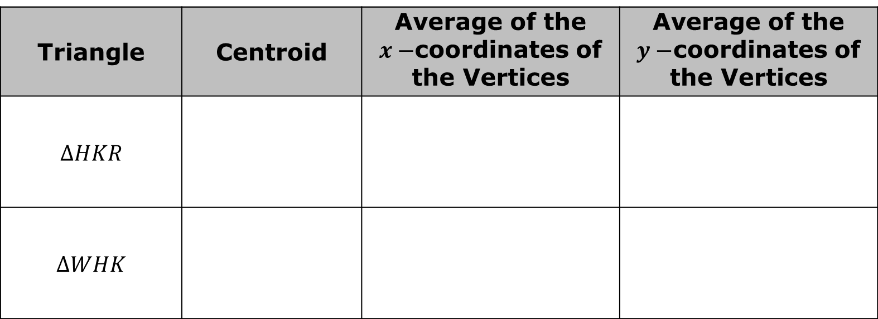
Use the centroids for $∆HKR$ and $∆WHK$ to complete the table.
Triangle | Centroid | Average of the $x−$coordinates of the Vertices | Average of the $y−$coordinates of the Vertices
$$∆HKR$$
$$∆WHK$$
Work with your partner to make a conjecture about the relationships of the centroid and the average of the 𝑥 and 𝑦 coordinates.
volume 2, pg. 324

Slide 14
Ask two classmates for their conjectures. Record their conjectures and write your summary of their conjectures. You are the only person who should write in the first two columns of the table. Have the person initial next to your summary stating that your summary was correct.
Conjecture | My Summary of Their Conjecture | Initials
volume 2, pg. 324

Slide 15
Review your conjecture with your partner. If necessary, make any changes.
volume 2, pg. 324

Slide 16

Collaboration
volume 2, pg. 325

Slide 17
13.7.3 Collaboration: Centroids of Triangles
$∆MBG$ has vertices at $M(0,−3)$, $B(8, 0)$, and $G(13,−7)$.
volume 2, pg. 325

Slide 18
What is the average of the 𝑥−coordinates?
What is the average of the 𝑦−coordinates?
What are the coordinates of the centroid?
Verify the coordinates of the centroid by drawing the median of each side.
volume 2, pg. 325

Slide 19

Your Turn
volume 2, pg. 325

Slide 20
13.7.4 Your Turn!
$∆PKR$ has vertices at $P(5,9)$, $K(9,3)$, and $R(−5,2)$.
What are the coordinates of the centroid of $∆PKR$?
volume 2, pg. 325

Slide 21
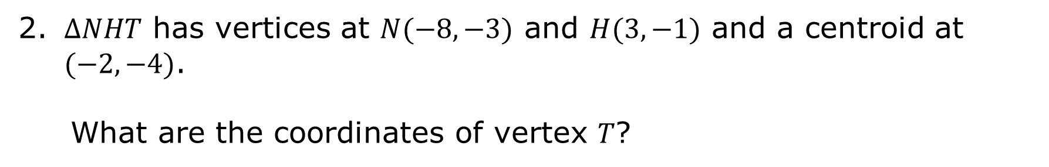
$∆NHT$ has vertices at $N(−8,−3)$ and $H(3,−1)$ and a centroid at $(−2,−4)$.
What are the coordinates of vertex 𝑇?
volume 2, pg. 326

Slide 22
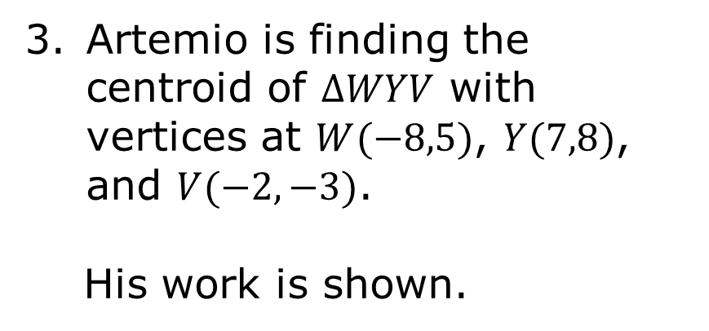
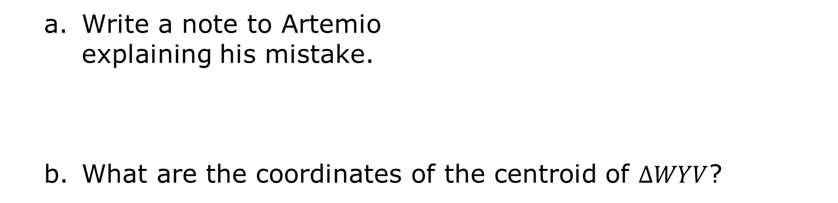
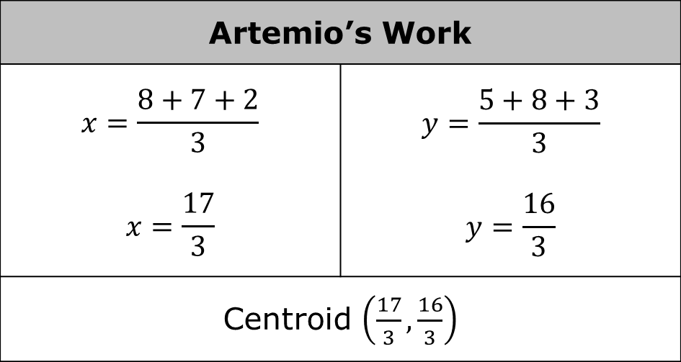
Artemio is finding the centroid of $∆WYV$ with vertices at $W(−8,5)$, $Y(7,8)$, and $V(−2,−3)$.
His work is shown.
Artemio’s Work
$$x=\frac{8+7+2}{3}$$ $$x=\frac{17}{3}$$ | $$y=\frac{5+8+3}{3}$$ $$y=\frac{16}{3}$$
Centroid $\left(\frac{17}{3},\frac{16}{3}\right)$
Write a note to Artemio explaining his mistake.
What are the coordinates of the centroid of $∆WYV$?
volume 2, pg. 326

Slide 23

Wrap-Up
volume 2, pg. 326

Slide 24
13.7.5 Wrap-Up: Ticket Out the Door
$∆TCH$ has vertices at $T(3,6)$, $C(10,−2)$, and $H(−4,2)$.
What are the coordinates of the centroid of $∆TCH$?
volume 2, pg. 326

